Slide 1



DoctorDirect IOHE Project
Team Members:
Anubhav Garg (2210991314), Anirudh Jamwal (2210991267), Harsh Goyal (2210991618),
Harsh Sharma (2210991624)
Supervised By: Dr.Ajay Katiyar
Department of Computer Science and Engineering
Chitkara University, Punjab

Slide 2
Content
Abstract
Introduction
Problem Statement
Objective
Significance
Scope
Use Cases
Methodology
Technology Stack
Future Scope
Conclusion

Slide 3
Abstract
DoctorDirect is an intelligent web-based application designed to simplify and digitize the process of booking medical appointments. Patients can effortlessly schedule appointments with their preferred doctors, while doctors can view, approve, or deny these requests through a dedicated portal. Once an appointment is approved, a secure QR code is generated, which patients use to access their medical reports—ensuring both privacy and convenience. The system supports real-time status updates, appointment history tracking, and report management. By automating traditional workflows, DoctorDirect reduces waiting times, eliminates paperwork, and improves the overall efficiency of healthcare delivery for clinics and hospitals.

Slide 4
Introduction
DoctorDirect is a web-based healthcare application designed to simplify the appointment booking process. Patients can search for doctors, book appointments, and get real-time approval or rejection based on the doctor’s availability.
Upon approval, a unique QR code is generated that patients can scan to securely access their medical reports, ensuring a fast, paperless, and contactless experience in clinics or hospitals.
The system reduces waiting time, eliminates paperwork, and improves communication between patients and doctors. With a user-friendly interface and scalable architecture, DoctorDirect is ideal for modernizing healthcare workflows and enhancing patient engagement.

Slide 5
Problem Statement
In traditional healthcare systems, booking doctor appointments often involves long waiting times, manual scheduling, and miscommunication between patients and doctors. Patients face difficulties in managing appointments and accessing their medical reports, while doctors struggle with unorganized appointment handling and excessive paperwork. There is a need for a digital solution that can streamline appointment management, provide real-time updates, and ensure secure and easy access to patient data. DoctorDirect aims to solve these issues by offering a user-friendly, secure, and scalable platform that enables efficient appointment booking, QR-based report access, and improved doctor-patient communication.

Slide 6
Objective
The primary objective of this project is to develop a smart, scalable doctor appointment booking system that enhances patient-doctor interaction through real-time scheduling and secure digital access. The platform is designed to improve efficiency, reduce paperwork, and provide a contactless healthcare experience for both patients and doctors.
Key Objectives:
To allow patients to easily book and manage appointments with doctors.
To enable doctors to approve or reject appointment requests in real time.
To generate a secure QR code for accessing patient reports digitally.
To implement secure user authentication and role-based access using JWT.
To offer a responsive and user-friendly interface for improved accessibility.

Slide 7
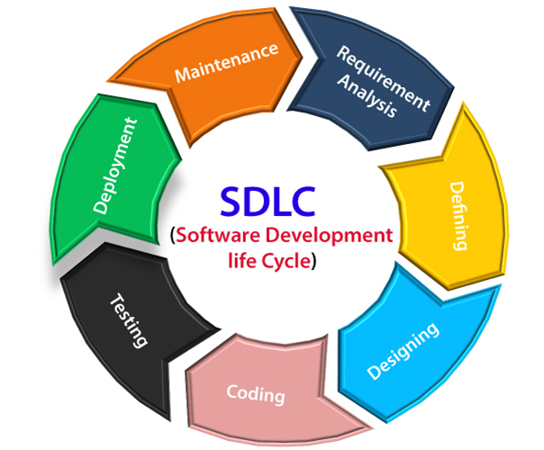
SDLC

Slide 8
Significance
In today’s fast-paced healthcare environment, traditional appointment systems are inefficient, prone to delays, and lack transparency. Patients often face difficulties in scheduling appointments, accessing reports, and receiving timely updates. Doctors, on the other hand, deal with unorganized scheduling and redundant paperwork.
DoctorDirect solves these challenges by offering a digital platform tailored for healthcare workflows. It enables real-time appointment booking, QR-based report access, and organized communication—making the process faster, safer, and more efficient. By reducing wait times, minimizing manual errors, and promoting contactless interaction, DoctorDirect enhances the overall patient-doctor experience and supports modern, tech-driven medical services.

Slide 9
Scope
Scope
Users can securely register, log in, and manage their roles as patients or doctors using JWT authentication.
Patients can book appointments and access reports through QR codes, while doctors can approve or reject requests in real time.
The system ensures reliable data storage and retrieval using a MongoDB-based backend for users, appointments, and reports.
DoctorDirect will enable online appointment booking and doctor consultation. It will improve accessibility and communication between patients and healthcare providers.

Slide 10
Use Cases
User A
A patient books an appointment with a dermatologist and receives a QR code after approval, which they use to access their medical report securely.
User B
A doctor manages appointments through a dashboard—approving or rejecting requests and checking patient details efficiently.
User C
A receptionist scans QR codes to instantly verify appointments, eliminating the need for manual registers or paper slips.
User D
A diagnostic lab uploads reports to the system, allowing patients to scan their QR code and download results quickly and securely.
These scenarios show how DoctorDirect simplifies healthcare workflows for patients, doctors, and clinics.

Slide 11
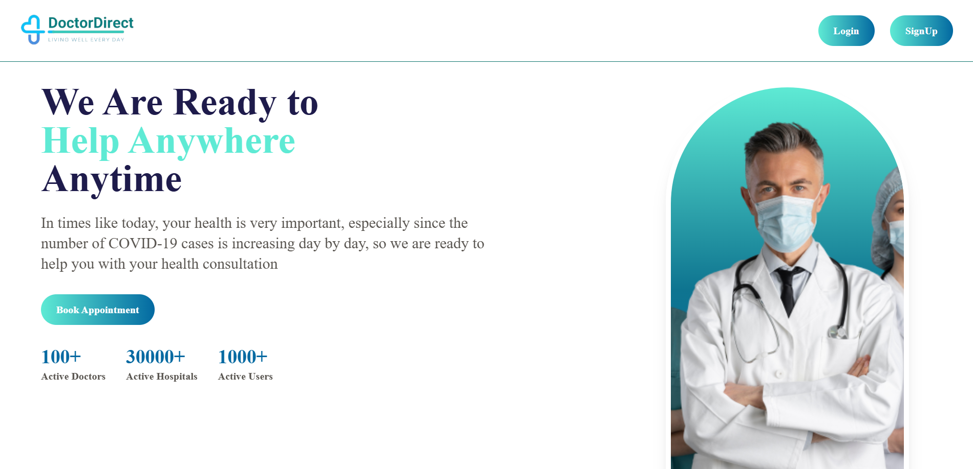
Fig. 1 (Home page)

Slide 12
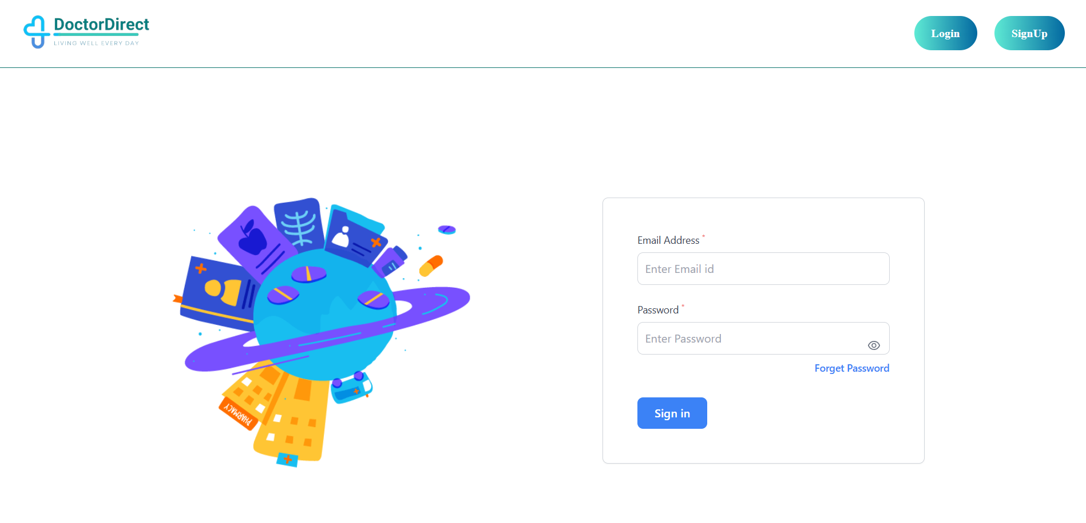
Fig. 2 (Login page)

Slide 13
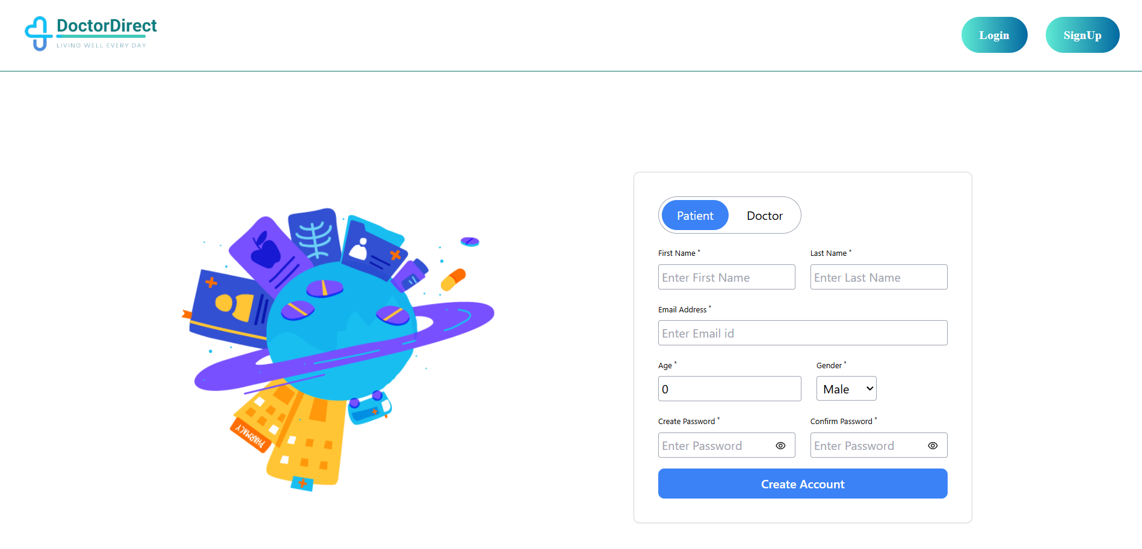
Fig. 3 (Signup page)

Slide 14
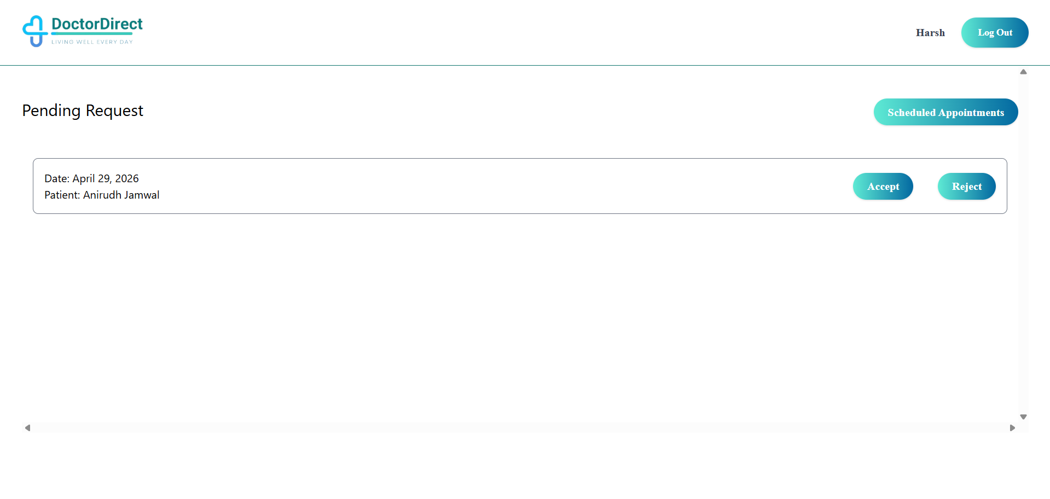
Fig. 4 (Booking Requests)

Slide 15
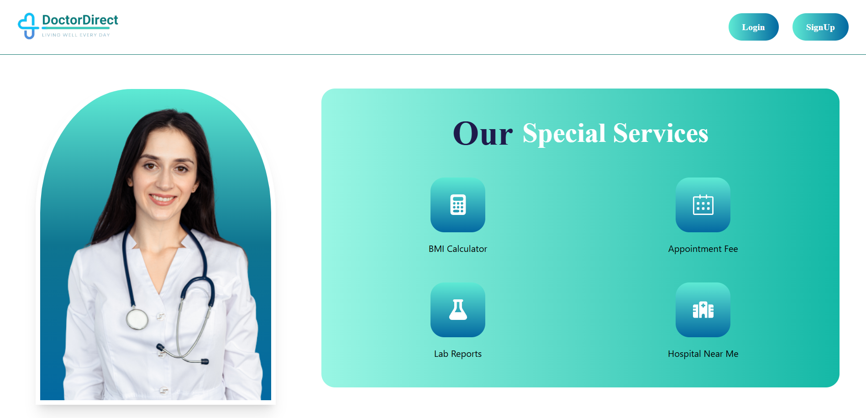
Fig. 5 (Special Services)

Slide 16
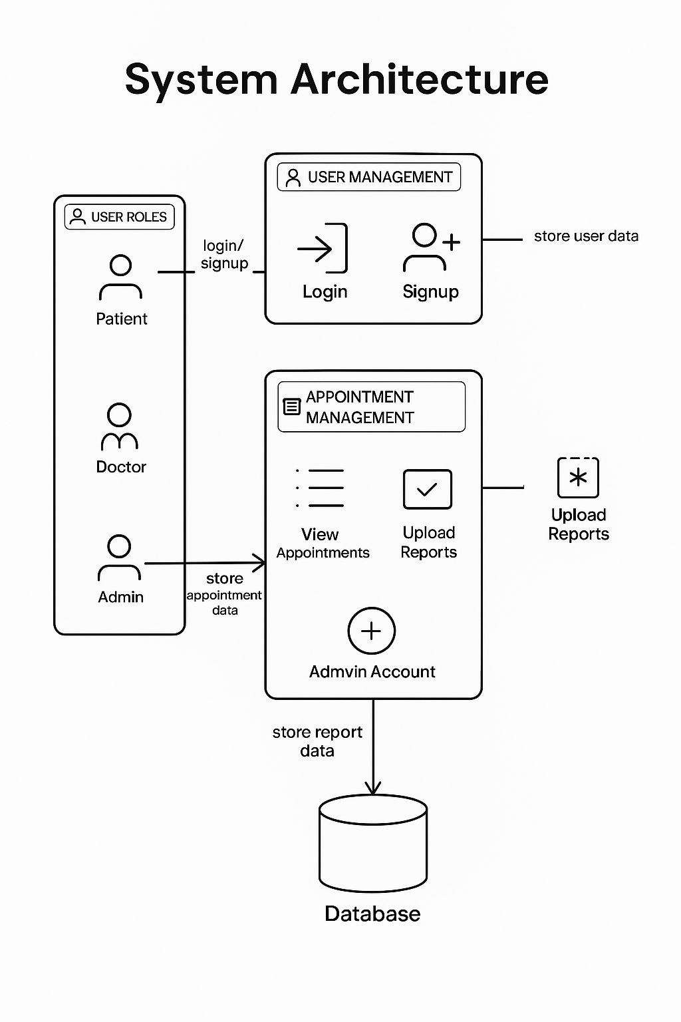
System Architecture

Slide 17
Methodology
Followed Agile methodology to plan, develop, and iterate features like appointment booking, QR-based report access, and role-based dashboards.
Designed the frontend using React.js and Tailwind CSS to ensure a clean, responsive, and user-friendly interface for both patients and doctors.
Developed the backend with Node.js and Express.js, implementing RESTful APIs, JWT-based authentication, and role-specific functionality.
Used MongoDB with Mongoose to handle structured data for users, appointments, and reports with flexibility and scalability.
Tested backend APIs using Postman, and maintained a modular, scalable codebase prepared for future features like notifications and video consultation.

Slide 18
Technology Stack
Development Approach:
Followed Agile methodology for planning and iterative development of features like appointment booking, QR report access, and dashboards.
Frontend:
Built using React.js and Tailwind CSS for a responsive, user-friendly, and clean interface across devices.
Backend:
Developed with Node.js and Express.js, implementing RESTful APIs and secure JWT authentication for patient and doctor roles.
Database:
Used MongoDB with Mongoose to store structured data for users, appointments, and reports efficiently.
Tools & Testing:
Tested APIs using Postman and maintained a modular codebase prepared for future updates like notifications and video consultations.

Slide 19
Future Scope
Voice & Video Consultation:
Integrate real-time doctor-patient consultations using WebRTC or third-party APIs like Twilio or Agora for remote healthcare access.
Calendar Sync:
Enable integration with Google Calendar or Outlook so patients and doctors receive automated reminders and manage appointments efficiently.
Mobile App Development:
Launch a cross-platform mobile app using React Native or Flutter to make the service accessible on smartphones and tablets.
Gamification & Engagement:
Introduce features like badges or progress tracking to encourage regular health checkups and proactive healthcare behavior.
Role-Based Access:
Implement advanced admin and support roles to help clinics manage multiple doctors, staff, and patient interactions within the system.

Slide 20
Conclusion
DoctorDirect offers a unified platform to streamline doctor-patient interactions through digital appointment booking, real-time status updates, and secure QR-based report access. By combining a responsive React.js frontend with a robust Node.js backend, the application enhances efficiency, transparency, and convenience in healthcare delivery.
With features like user authentication, role-based access, and report management, DoctorDirect solves key challenges in traditional medical workflows. It also lays the groundwork for future additions such as video consultations, cloud integration, and mobile support — making it a scalable, secure, and patient-friendly solution for modern healthcare systems.

Slide 21
T H A N K Y O U

